Slide 1

ProjectX Solution Type: Prototype, Blog/Video, Workshop Content
Muhammad Junaid Qamar
Ijlal Ahmed
Anam
Notes:
Korrie

Slide 2
The Opportunity
The Need for Real-Time Security Solutions
Problem Statement: Public and private spaces need proactive security solutions to mitigate theft and suspicious activities.
Current Gaps:
Traditional systems are reactive rather than preventive.
Lack of real-time monitoring and alert capabilities.
Our Goal: To develop a real-time AI-powered theft detection system that empowers users to take quick and effective actions.
Notes:
Korrie
updated 7/21

Slide 3
Solution
AI-Driven Theft Detection System
How It Works:
Motion Detection: Uses YOLOv4 for real-time object detection and tracking.
Suspicious Activity Alerts: System sends instant email notifications upon detecting anomalies.
Key Advantages:
Real-time detection and notification.
Affordable and scalable security solution.
Built on cutting-edge deep learning models, YOLOv4.
Notes:
Korrie
updated 7/21

Slide 4
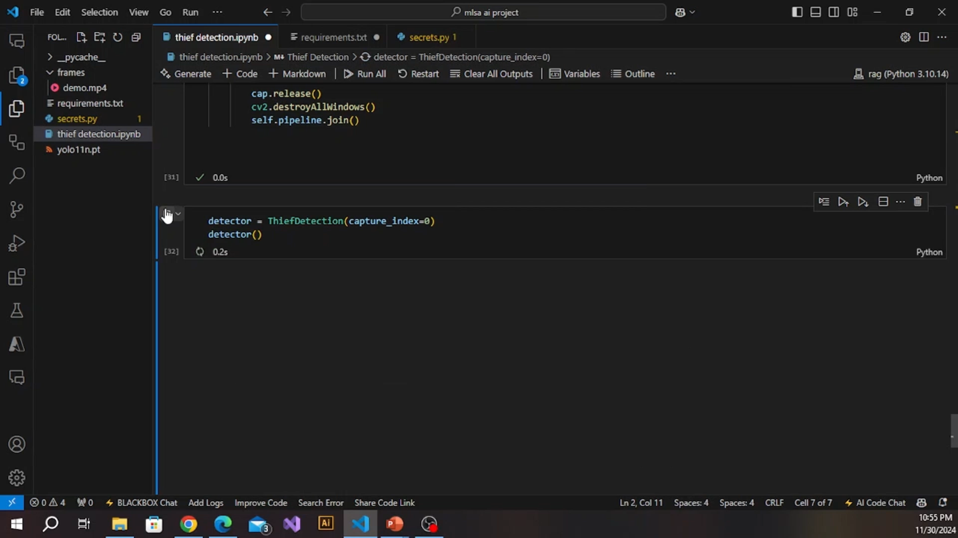
Demo
Notes:
Korrie
updated 7/21

Slide 5
Takeaways
Final Thoughts
Achievements:
Created a functional prototype using Azure Virtual Machines.
Integrated YOLOv4 for motion detection.
Overcame initial data collection and model selection challenges.
What’s Next:
Expanding datasets to improve model accuracy.
Exploring additional object detection models for broader use cases.
Enhancing alert mechanisms with email integration.
Call to Action:
Embrace AI-powered security for safer indoor spaces.
Notes:
Korrie
updated 7/21

